Slide 1
Generics, Collection and Events
Course Code: CSC 2210
Course Title: Object Oriented Programming 2
Dept. of Computer Science
Faculty of Science and Technology
Lecturer No: | 09 | Week No: | 10 | Semester: | Summer 2019-2020
Lecturer:

Slide 2
Topics
Generics
Collection
Events

Slide 3
Generics

Slide 4


Slide 10
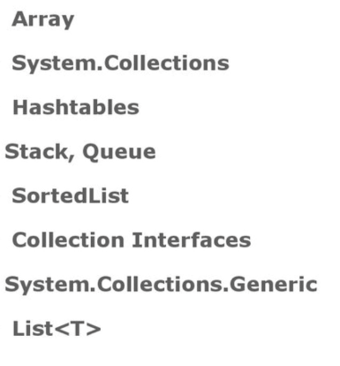
Collections

Slide 11
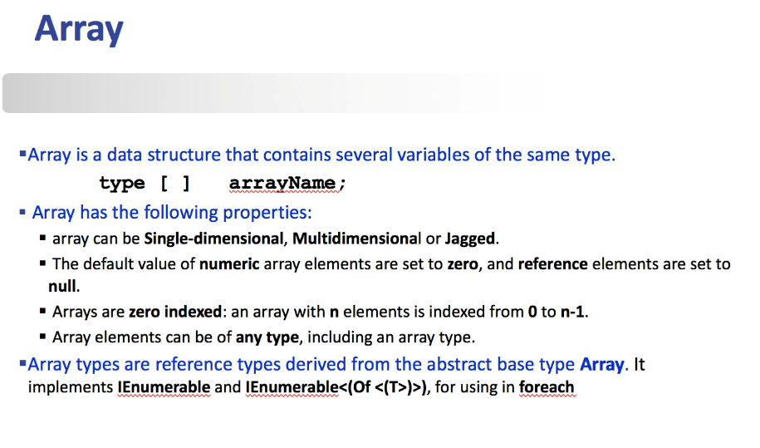

Slide 12
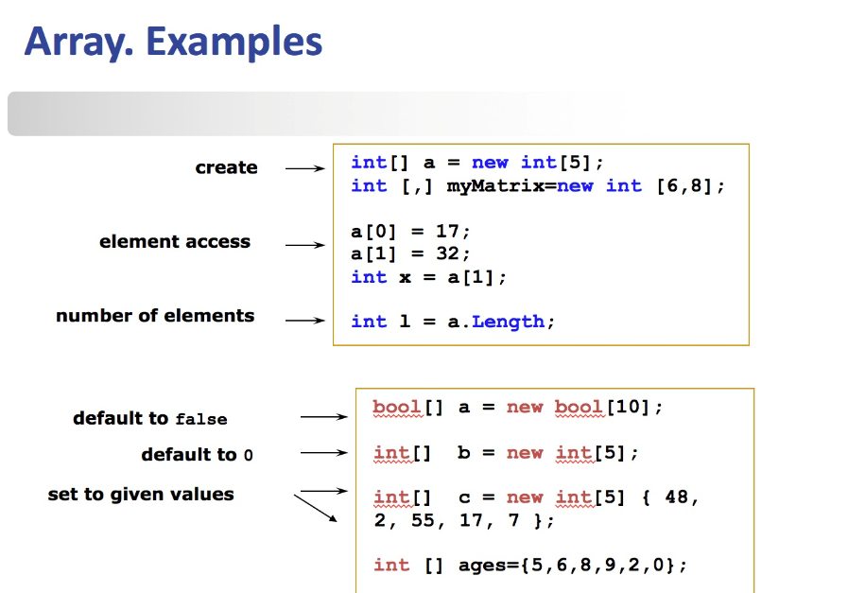

Slide 13
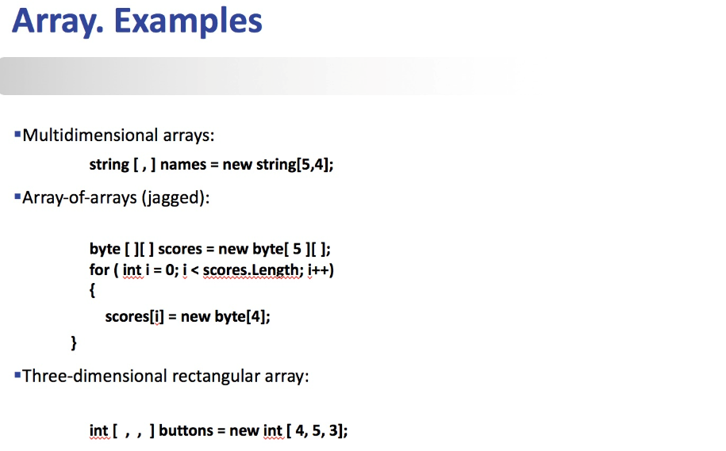

Slide 14
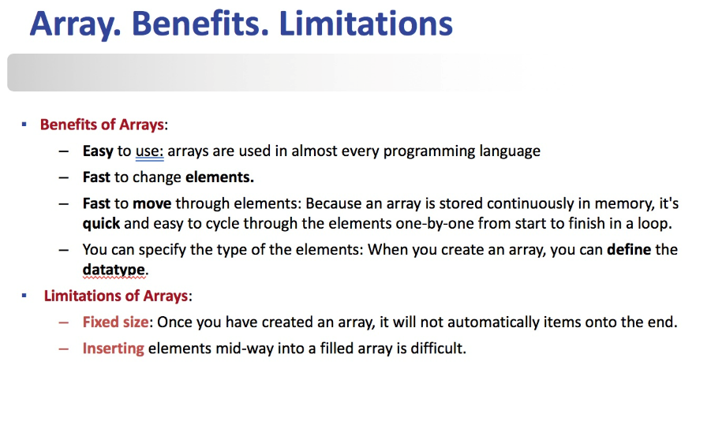

Slide 66

Thank You

Slide 67
Books
C# 4.0 The Complete Reference; Herbert Schildt; McGraw-Hill Osborne Media; 2010
Head First C# by Andrew Stellman
Fundamentals of Computer Programming with CSharp – Nakov v2013

Slide 68
References
MSDN Library; URL: http://msdn.microsoft.com/library
C# Language Specification; URL: http://download.microsoft.com/download/0/B/D/0BDA894F-
2CCD-4C2C-B5A7-4EB1171962E5/CSharp%20Language%20Specixfication.doc
C# 4.0 The Complete Reference; Herbert Schildt; McGraw-Hill Osborne Media; 2010

